Slide 1


GloboDiet Specific interview techniques
INTERNATIONAL AGENCY FOR RESEARCH ON CANCER LYON - FRANCE
e-SMP

Slide 2

GloboDiet steps and procedures
Interview techniques
Quality control at end of interview
Time/length of the interview
GloboDiet training:
IARC, Lyon - France
Specific interview techniques

Slide 3

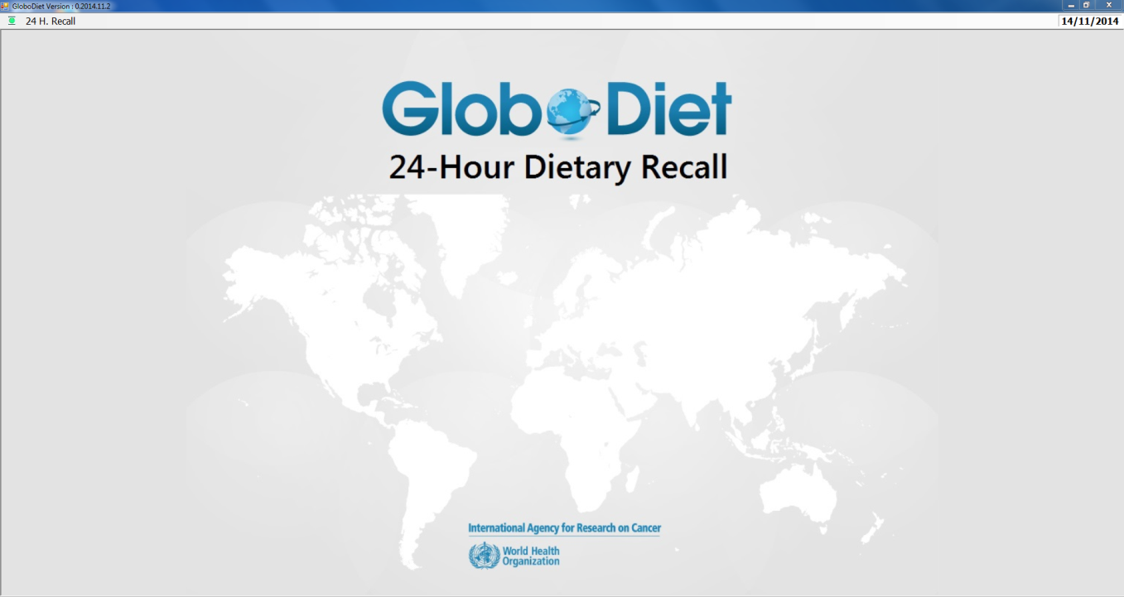

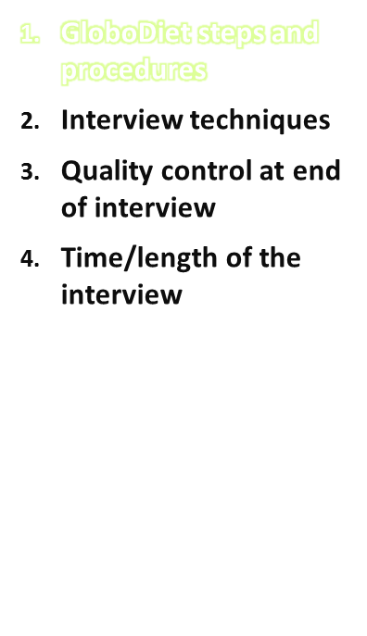
Know the GloboDiet steps & procedures and be familiar with the questions (facets) & answers (descriptors) to be asked!
GloboDiet training:
IARC, Lyon - France
Specific interview techniques

Slide 4
3 Step method
Step 1: Quick List
  Get a list of all foods eaten without trying to determine amounts
  The respondent should tell you everything eaten or drunk, including snacks, coffee breaks, alcoholic beverages, even carbonated water – either eaten at home or away from home.
Step 2: Detailed Description
  Get more complete info on foods already reported
    “Do you remember anything else you ate or drank with this food?”
    “Was this (bread, vegetable) eaten plain or did you put something on it?”
    “How much did you eat?”
Step 3: Final check (at the end of interview)
    Review the 24 hour list, and do the final quality check
    However, don’t provide any feedback to the respondent!
GloboDiet training:
Specific interview techniques
IARC, Lyon - France

Slide 5
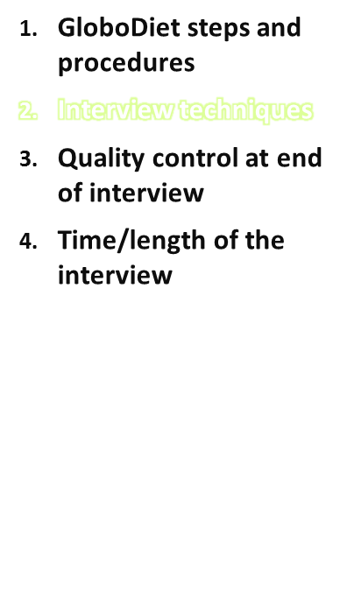
Some GloboDiet specific general interview techniques should be considered when conducting a GloboDiet 24-h recall interview
GloboDiet training:
IARC, Lyon - France
Specific interview techniques

Slide 6

Interview Techniques
Take notes whenever there is a problem/doubt:
  to update the GloboDiet databases (something missing)
  to update a recipe…
  → distinguish general notes from specific ones
  automatic notes are produced by GloboDiet if new
  food/recipe, exceeded or missing quantity
  all notes are identified by a flag
Quantify what has been eaten, not served
Choice for quantification method has to be made by the respondent
  ‘how much did you eat?’, mention the quantification possibilities from your screen if necessary
The quantity for a cooked food can be entered as cooked weight or raw → be aware that this influences the calculated consumed weight
GloboDiet training:
Specific interview techniques
IARC, Lyon - France

Slide 7
Interview Techniques
For fat on bread, it is pointless to ask whether ‘there was some fat left on the dish’
Distinguish ‘raw’ from ‘cooking method not applicable (N/A)’:
  Canned foods eaten cold must be described as N/A
  Dried fruits eaten as such must be described as N/A
  (Fresh) bread must be described as N/A.
Bread:
  If fresh and quantified in g, answer the weight is as ‘cooked/not applicable’
  If the bread is cooked and quantified in g, the weight will usually be as ‘raw’ to allow the raw-to-cooked coefficient
GloboDiet saves automatically & periodically. In case of a break or power cut during the 24HR, use the ‘resume interview’ function to retrieve the data.
GloboDiet training:
Specific interview techniques
IARC, Lyon - France

Slide 8
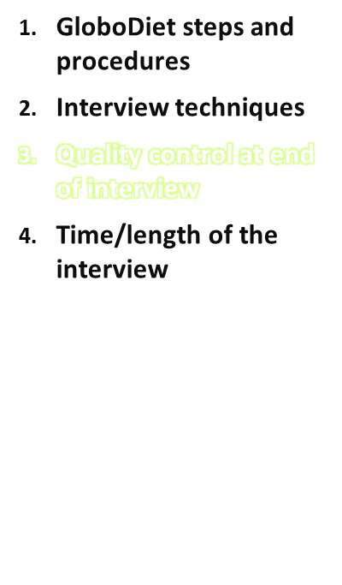
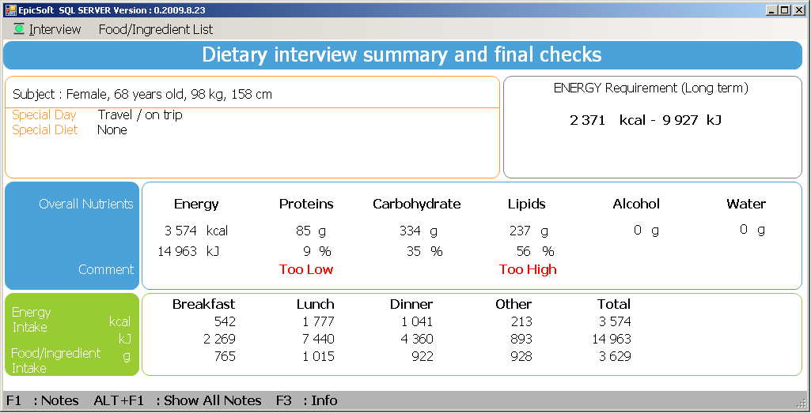
At the end of the interview, the energy and macronutrient intakes of the respondent are being compared with his/her age & gender specific nutrient recommendations
NOTE: Very rough estimation of energy & nutrient intake!
GloboDiet training:
IARC, Lyon - France
Specific interview techniques

Slide 9
Quality control at end of interview
GloboDiet training:
Specific interview techniques
IARC, Lyon - France

Slide 10
Quality control at end of interview
This control should be done only if a warning is displayed (out of range values). The interviewer can be faced to different situations when values are out of range:
  The out of range values may be due to under/over-reporting of the subject or to accurate recall but out of the expected range → ask questions to the subject, without making any judgment, and check that what has been reported is correct (e.g. by making a brief summary of what has been reported and asking confirmation). If there is any doubt about the accuracy of the 24-h recall, enter comments in the NOTE file (F1).
  The out of range values may be explained by the answer given about a “special day”, “special diet” → better not to ask the subject any further questions (or ask only for confirmation, if any doubt).
  There might be a mistake in the 24-h recall. Go through the list and see whether high/low values of energy or grams reported in the FCO give any information about the mistake (e.g. a food entered twice, typing error not identified by the quality controls on maxima) → Go back to description/quantification screen to correct the error.
GloboDiet training:
Specific interview techniques
IARC, Lyon - France

Slide 11
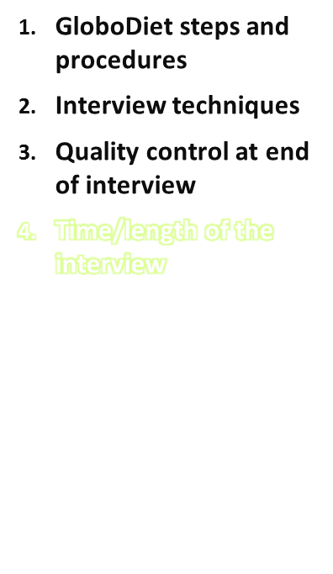
Be aware that the time/length of the interview recorded depends on the time on which the interviewer “opens a new interview” and “ends the interview”
  Start new interview when the respondent is in front of the interviewer (don’t open the “new interview” screen beforehand since this will bias the registered interview time)
  End the interview when the 24-h recall ends → save and exit the interview to make sure the time (duration) of the interview is stopped
GloboDiet training:
IARC, Lyon - France
Specific interview techniques

